Slide 1
Internship Week 1
Samarth Sharma

Slide 2
Implementing on Pynq-Z2

Slide 3
A simple adder
Understood basic syntax for writing python drivers in pynq.
Read about AXI interfaces and handshaking.
Tried implementing the same lab using MMIO read/write.
Understood how to deal with negative values.

Slide 4
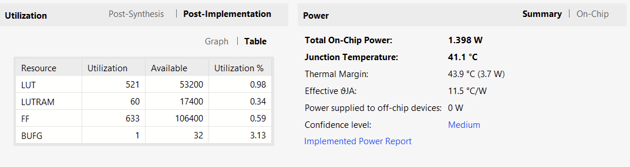
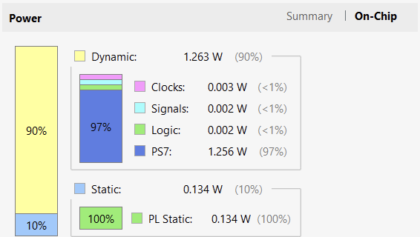

Slide 5
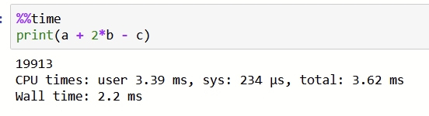
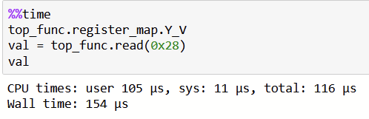
Software impl.
Hardware impl.
Acceleration time = SW time/HW time = 2.2ms/154 mus = 14.29 approx.

Slide 6
Reconfigurable FFT
2 DMAs were used with a reconfigurable FFT IP.
Understood how hierarchies are created in Vivado.
Learnt about configuring FFT IP.
Since a lot of code was redundant, learnt how we can create drivers to prevent writing the same code again and again.

Slide 7

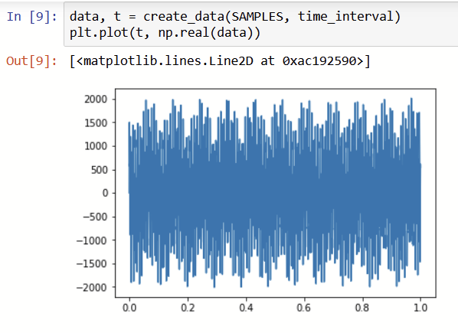

Slide 8
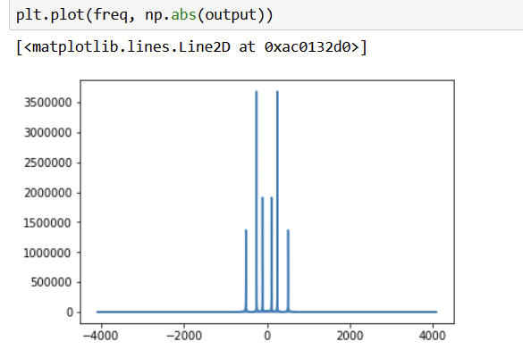
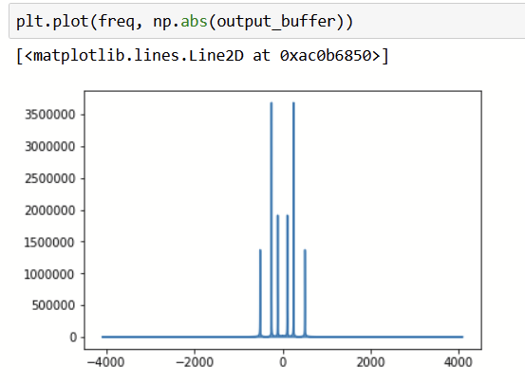

Slide 9
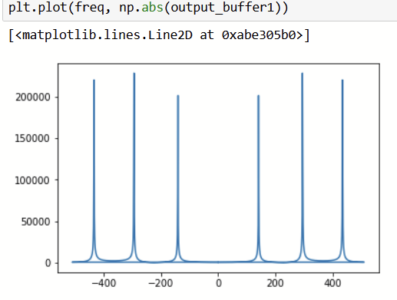
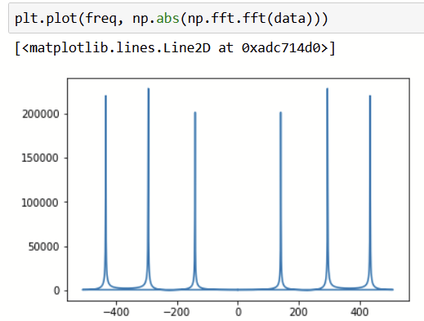

Slide 10
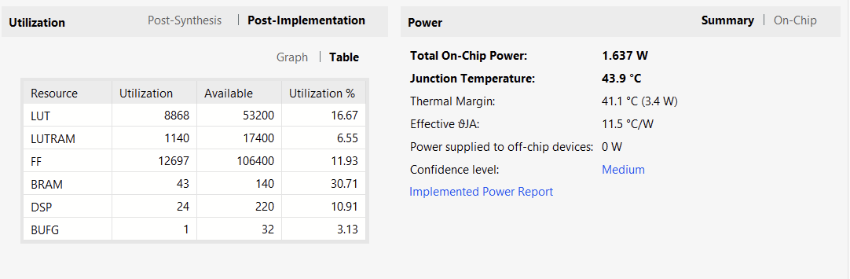
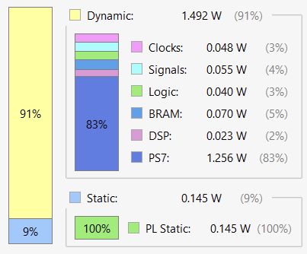



Slide 11
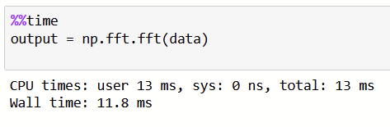
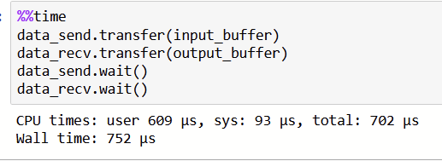
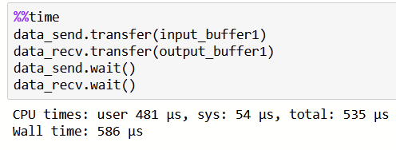
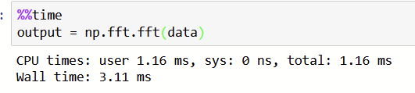
Software impl.(8192)
Hardware impl. (8192)
Software impl.(1024)
Hardware impl. (1024)
Acceleration time(8192) = SW time/HW time = 11.8ms/752 mus = 15.69 approx.
Acceleration time(1024) = SW time/HW time = 3.11ms/586 mus = 5.31 approx.

Slide 12
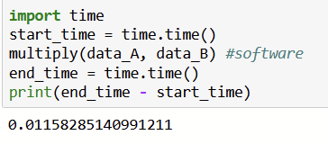
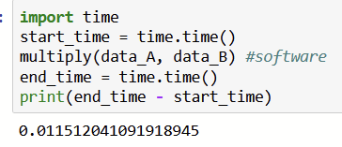
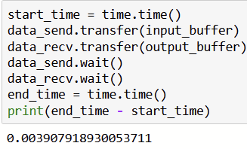
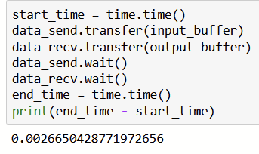
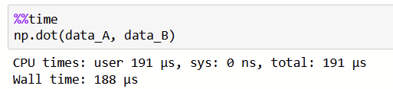
Matrix Multiplication(8x8)
OPTIMIZED
UNOPTIMIZED
PS time (using numpy)
Acceleration time
= 0.011/0.0039 = 2.82
Acceleration time
= 0.14/0.00267 = 52.43

Slide 13
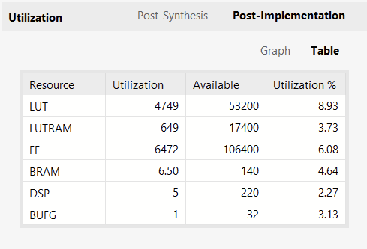
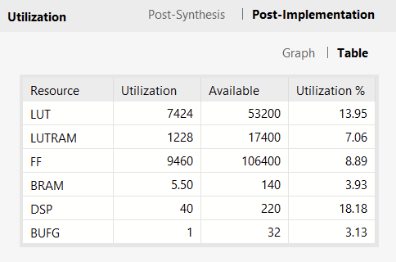
UNOPTIMIZED
OPTIMIZED (No Word Length Opt)

Slide 14
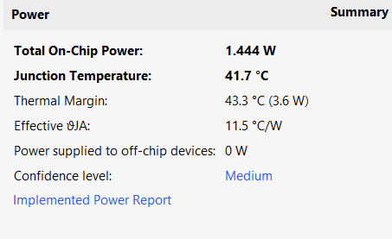
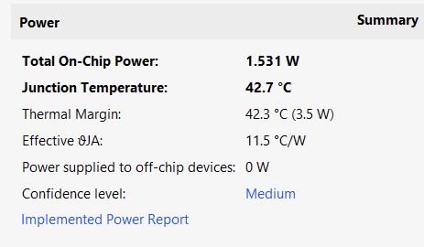
UNOPTIMIZED
OPTIMIZED (No Word Length Opt)

Slide 15
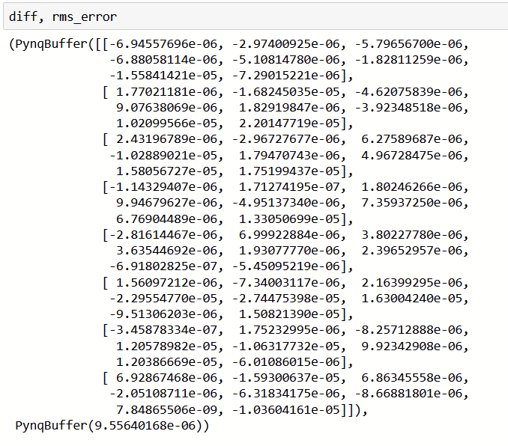
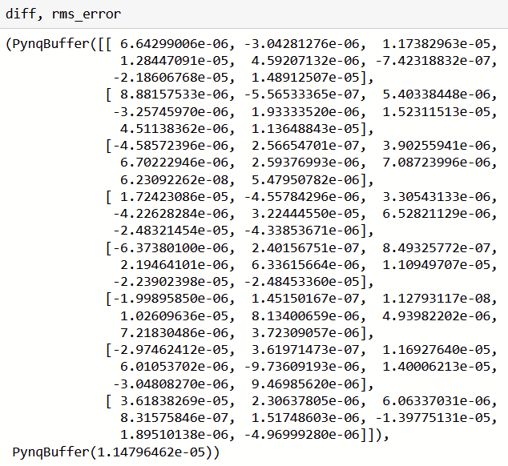
UNOPTIMIZED
OPTIMIZED
RMS error = 9.55e-6
RMS error = 1.14e-5

Slide 16
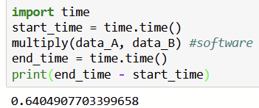
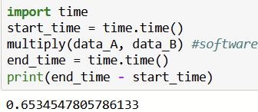
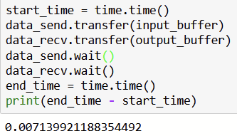
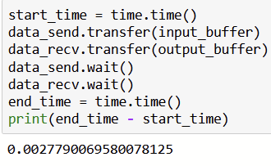
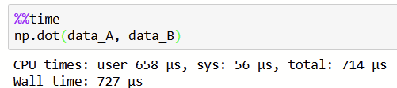
Matrix Multiplication (32x32)
UNOPTIMIZED
OPTIMIZED
PS time (using numpy)
Acceleration time
= 0.64/0.007 = 91.43
Acceleration time
= 0.653/0.0023 = 283.91

Slide 17
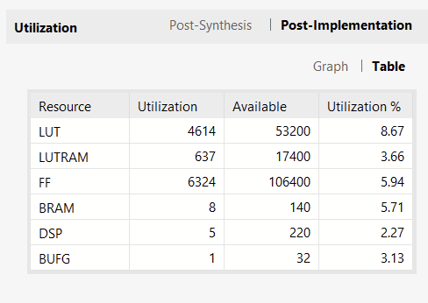
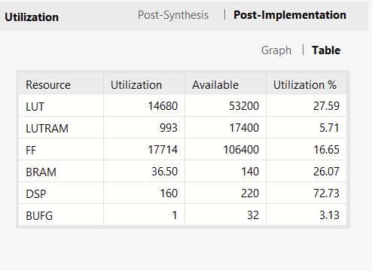
UNOPTIMIZED
OPTIMIZED (No Word Length Opt)

Slide 18
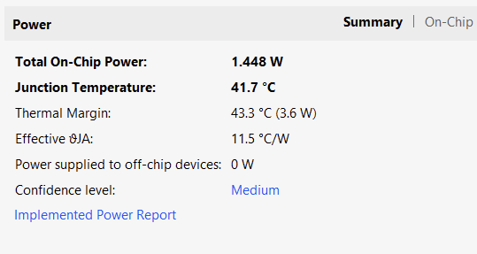
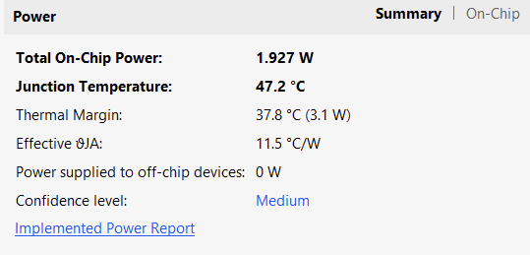
UNOPTIMIZED
OPTIMIZED (No Word Length Opt)

Slide 19
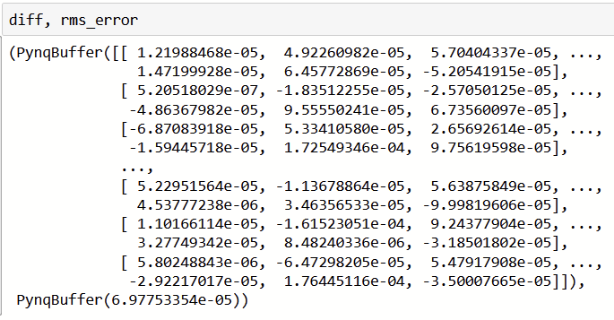
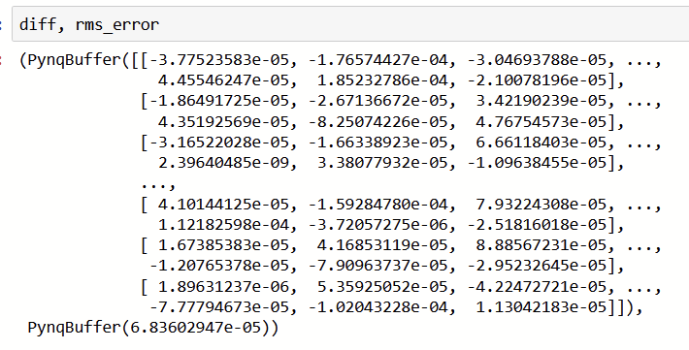
Errors
RMS error = 6.97e-5
RMS error = 6.84e-5

Slide 20
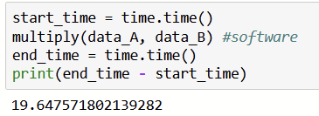
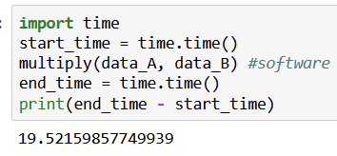
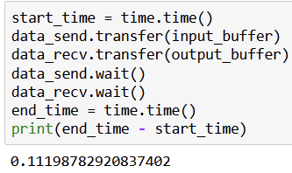
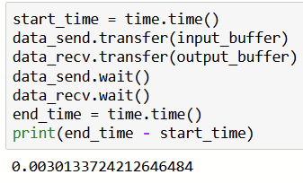
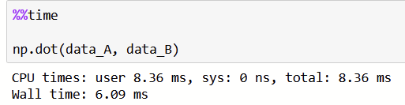
Matrix Multiplication 100x100
UNOPTIMIZED
OPTIMIZED (+ Word Length Opt)
PS time (using numpy)
Acceleration time
= 19.65/0.112
= 175.45 approx.
Acceleration time
=19.52/0.003
= 6506.67 approx.

Slide 21
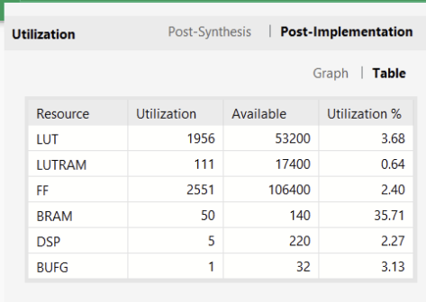
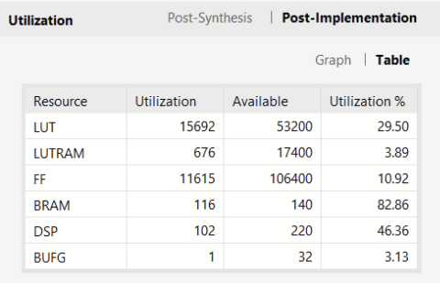
UNOPTIMIZED
OPTIMIZED (+ Word Length Opt)

Slide 22
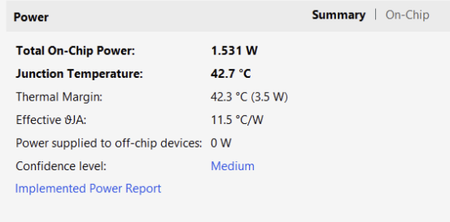
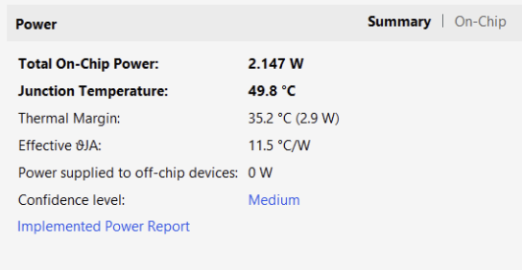
UNOPTIMIZED
OPTIMIZED (+ Word Length Opt)

Slide 23
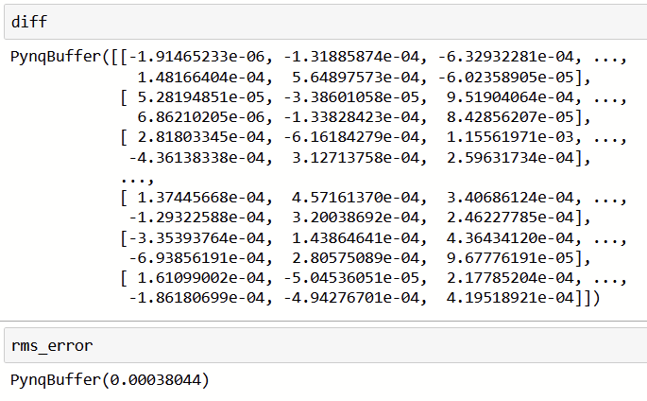
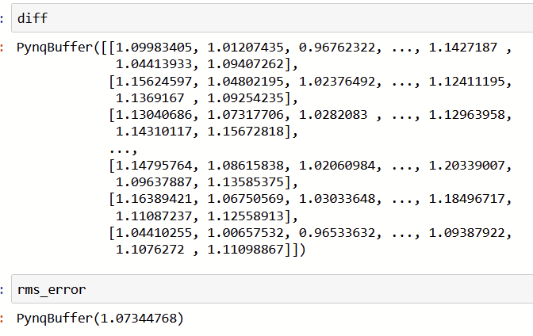
Error
UNOPTIMIZED
OPTIMIZED (+ Word Length Opt)
RMS error = 1.07 approx. (This is very high, so we try to update WLO to get this lower)
RMS error = 4e-4 approx.

Slide 24
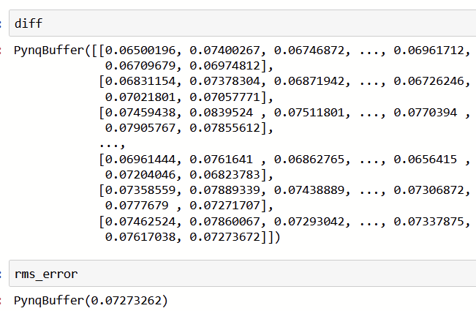
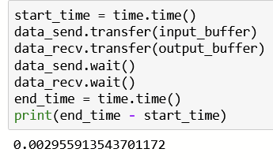
Changing WLO
Optimal found: <22,11>
Acceleration time
=19.52/0.003
= 6506.67 approx.
RMS error = 0.072

Slide 25
Thank You!

